Slide 1
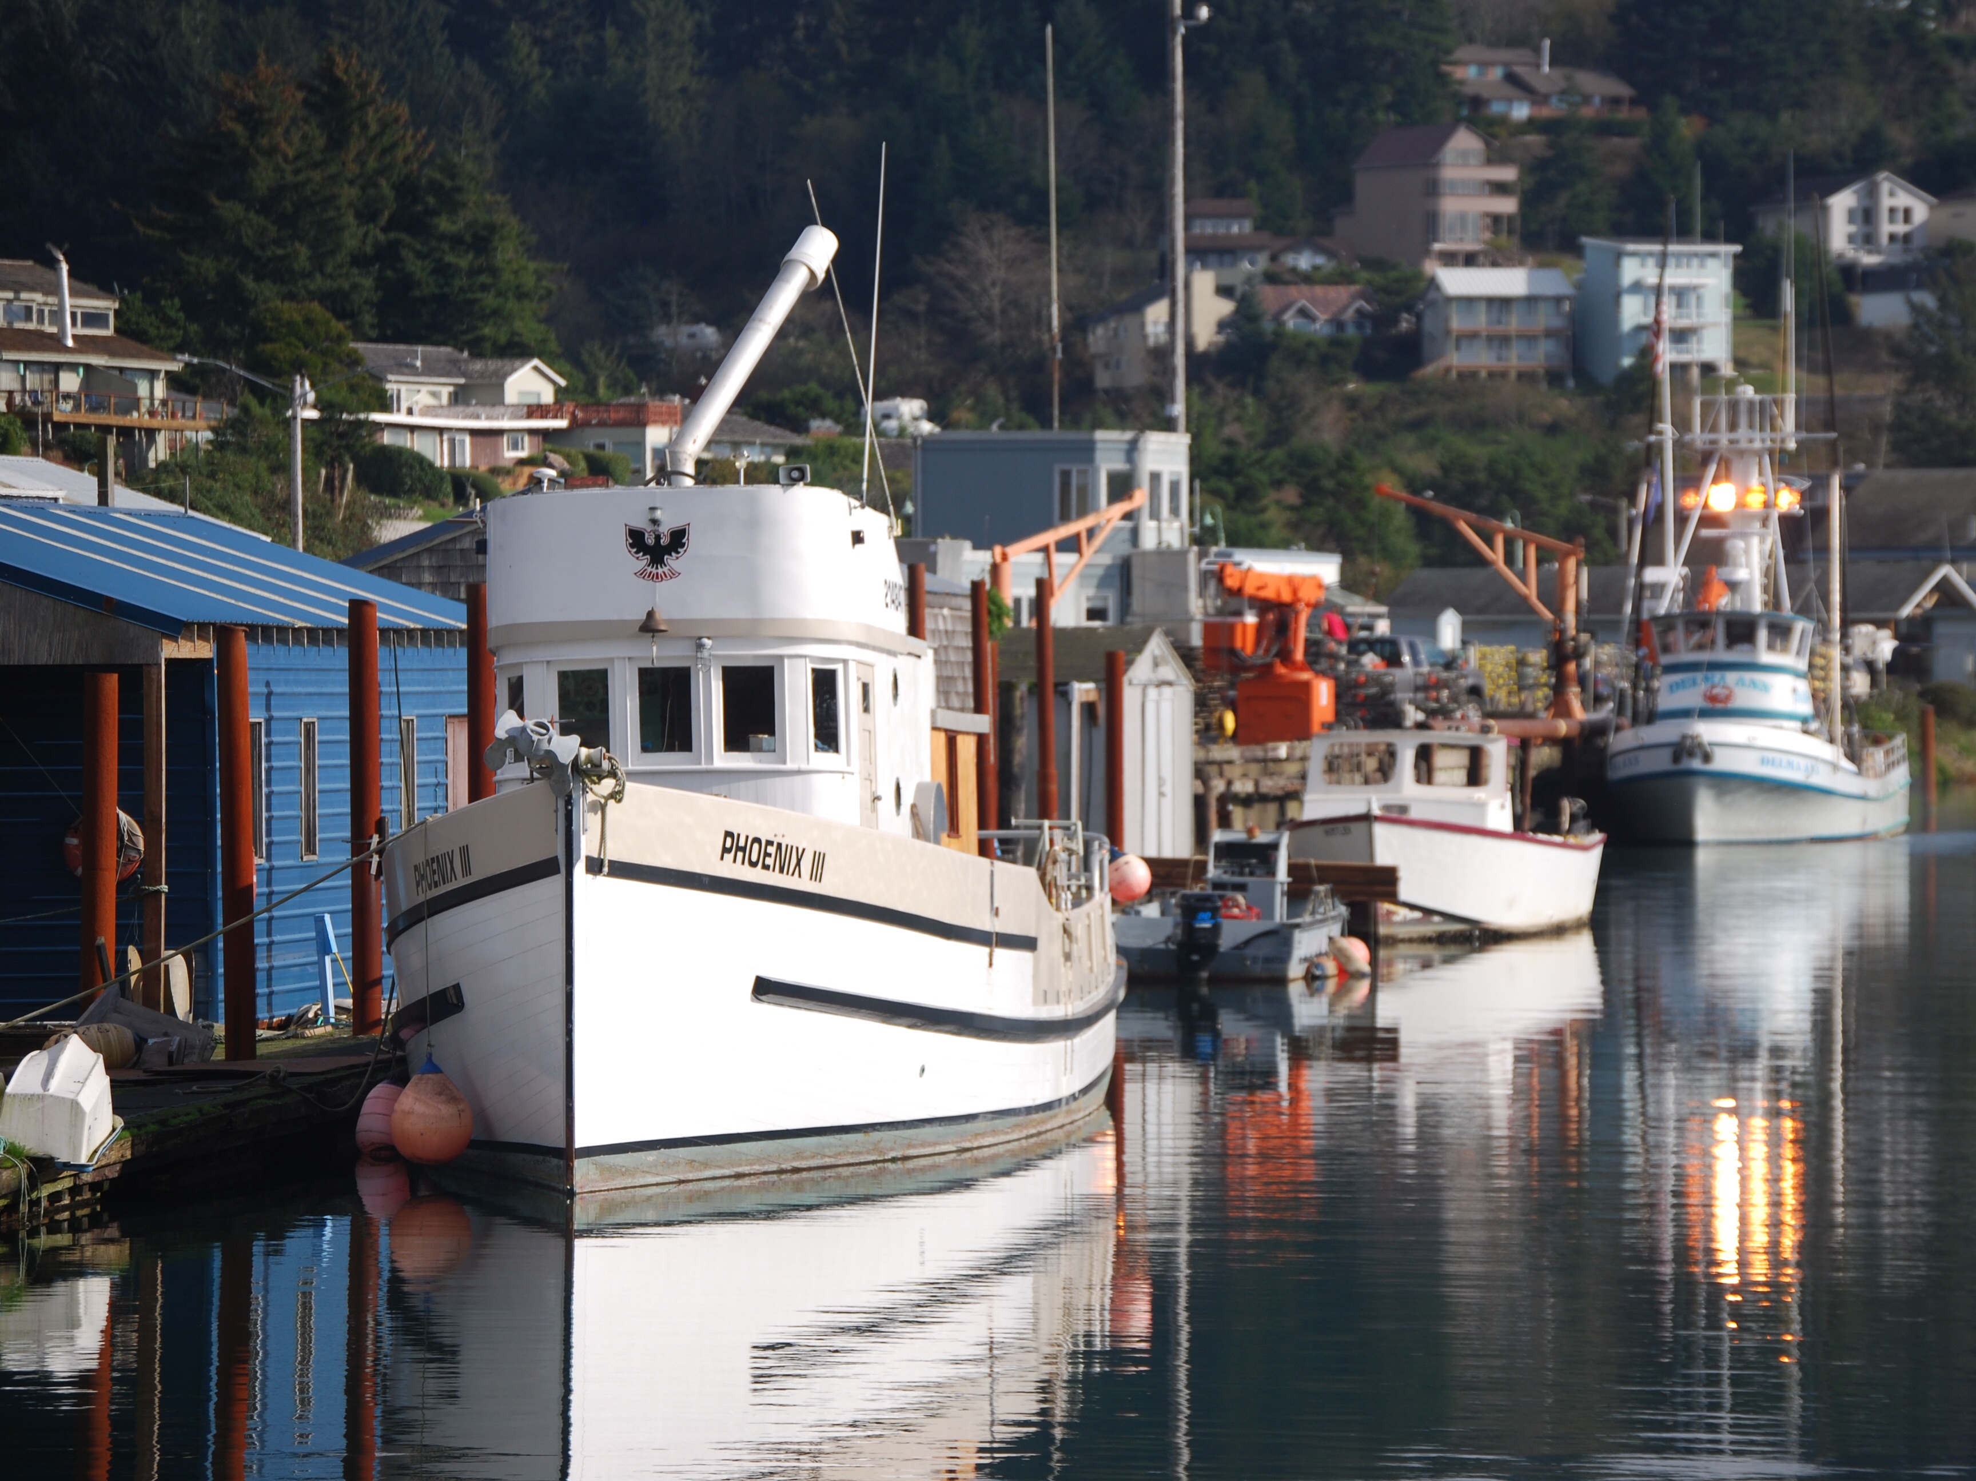

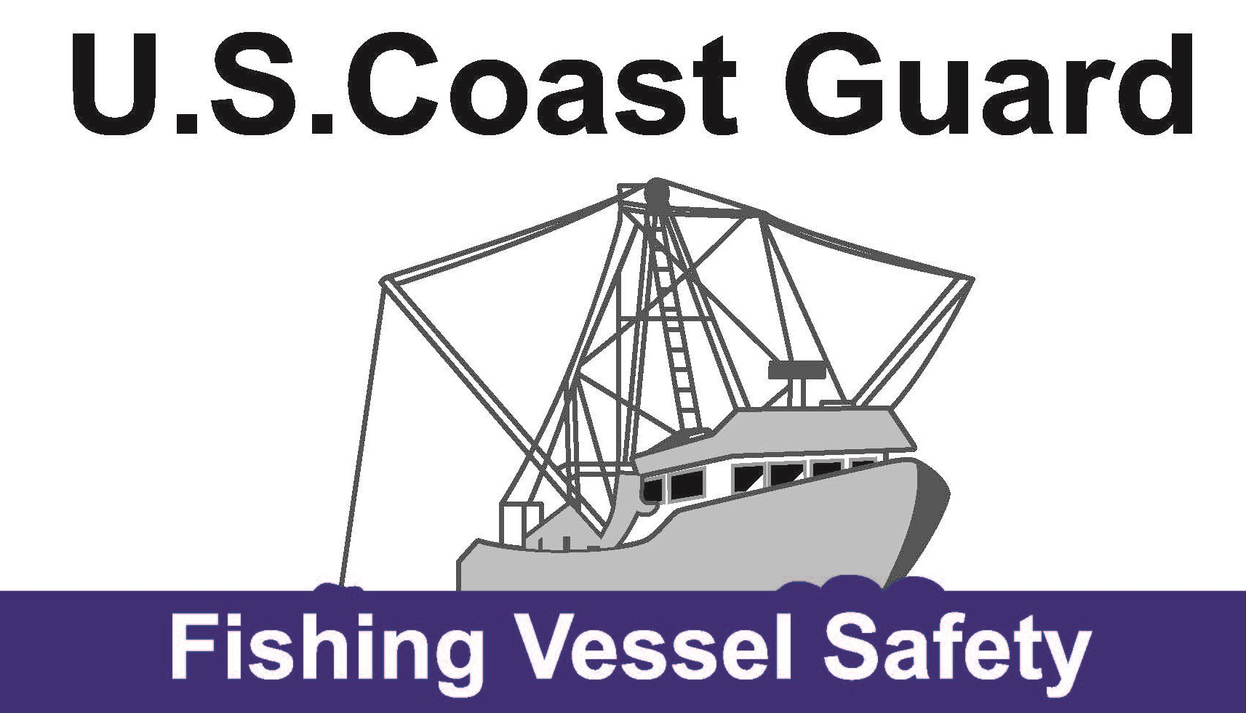
Thirteenth District Update
National Commercial Fishing Safety Advisory Committee
Jacksonville, FL—April 2024
Mr. Mike Rudolph, Fishing Vessel Safety Coordinator
U.S. Coast Guard—Thirteenth District

Slide 2
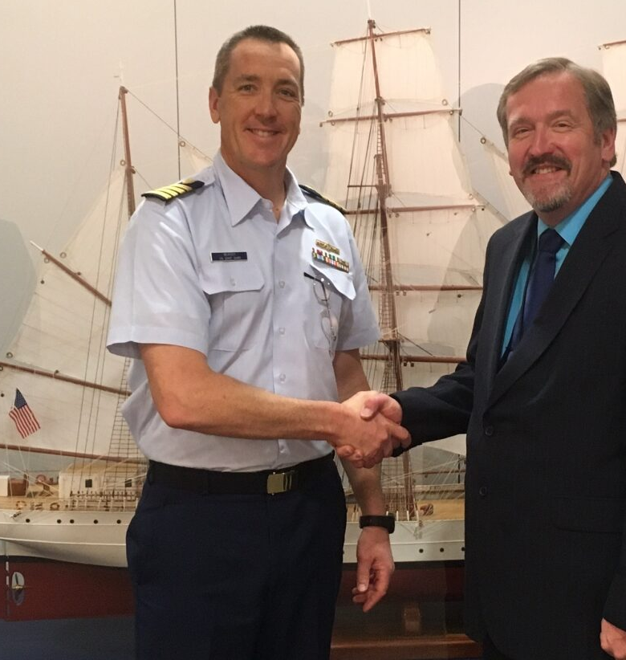
Dan Hardin retired Aug 2023 D13 icon who invented FishSafeWest.info and the Checklist Generator. Dan served a total of 50 years with the Coast Guard--25 of them dedicated to Fishing Vessel Safety.
Thank you Dan!

Slide 3
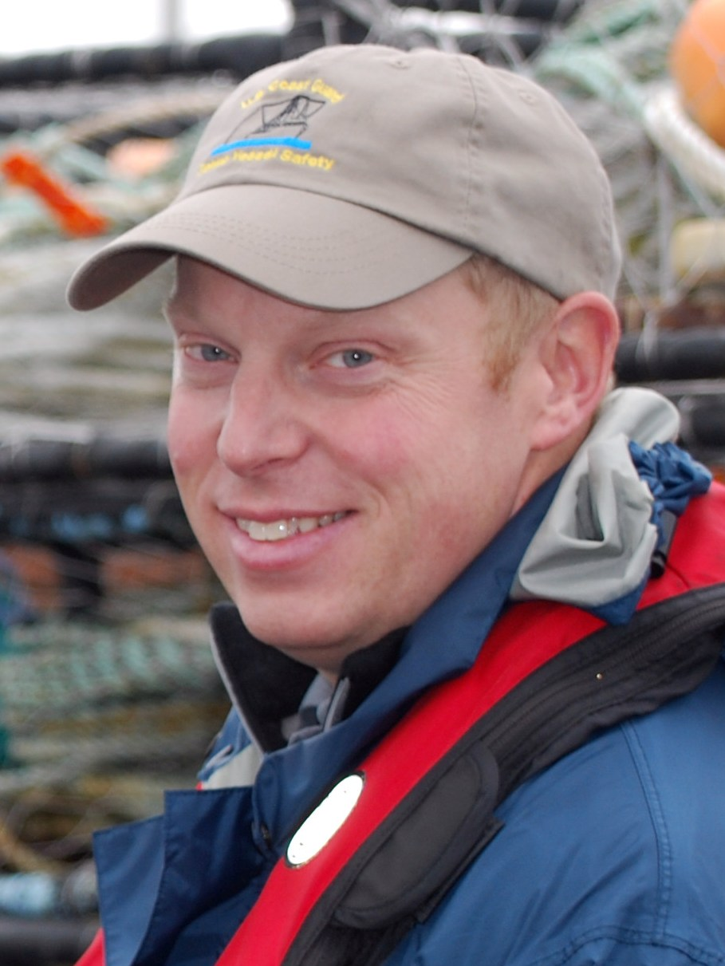
Mike Rudolph onboard Jan 2024 Longtime Fishing Vessel Safety Examiner and Trainer spanning 30 years of service in Alaska, Washington and Oregon. New administrator of FishSafeWest.info website and Checklist Generator
Meet the New Guy

Slide 4
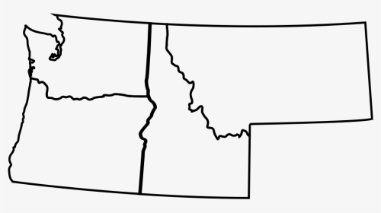
Staffing and Geography
SEATTLE, WA
District Thirteen
Sector Puget Sound
PORTLAND, OR
Sector Columbia River
NORTH BEND, OR
SCR-Detached-Duty
STAFFING: D13 is billeted for 10 full-time civilian employees. Current staffing is at <70% effectiveness.
GEOGRAPHY: 68% of all Sector Puget Sound activities are in/around the Seattle area. Most Sector Columbia River exams are located 2+ hr drive away from Portland.

Slide 5
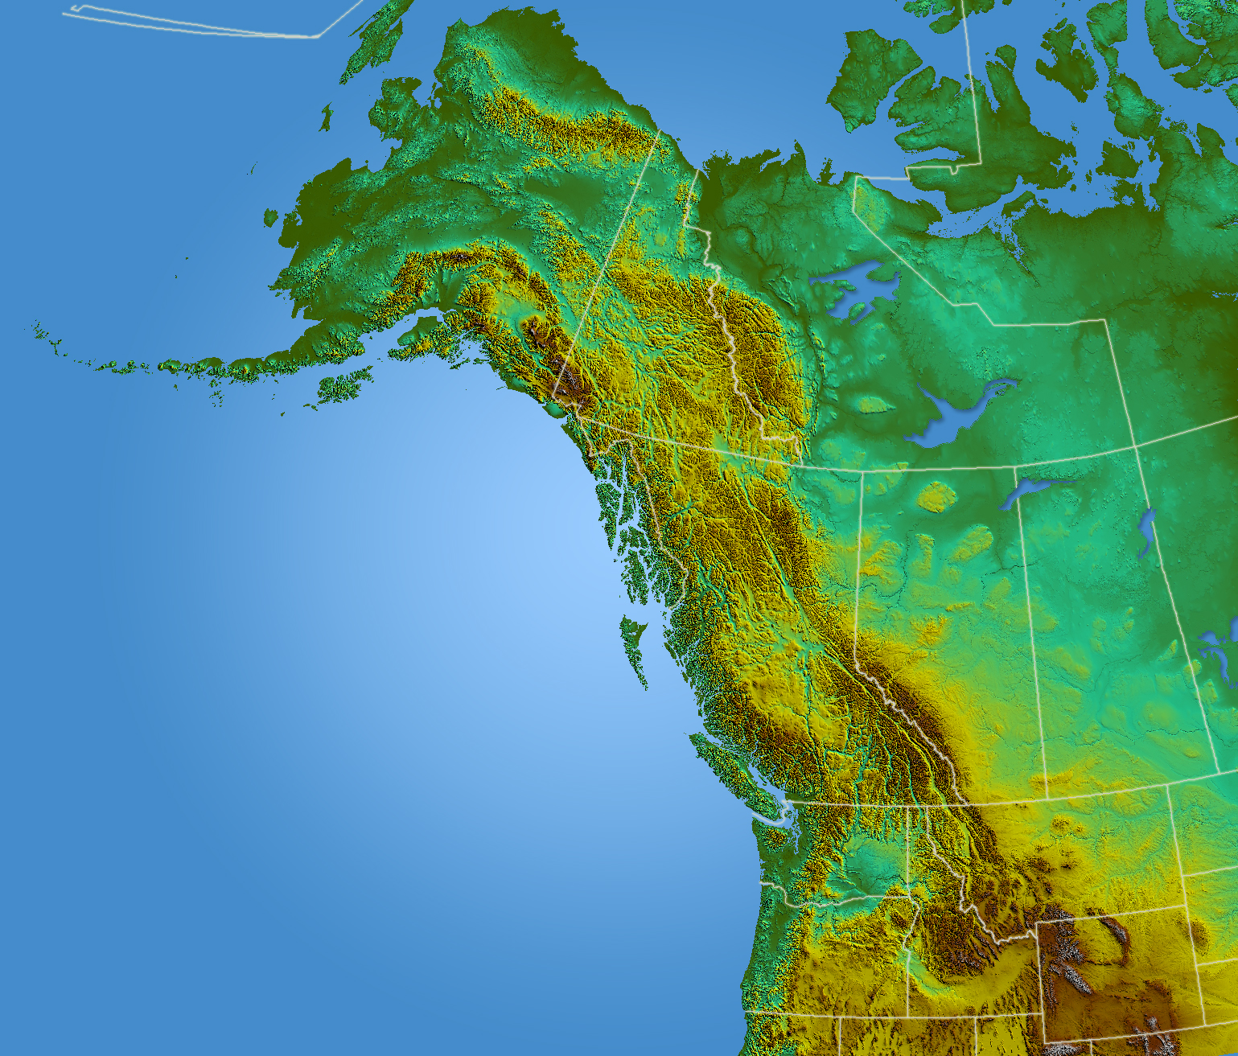
Fishing Industry Vessel Fleets
Of the estimated 3,600 Fishing Industry Vessels homeported in D13, approx. 30% operate primarily in D17

Slide 6
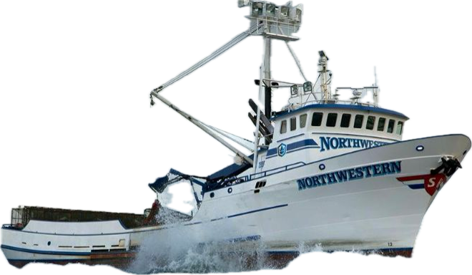
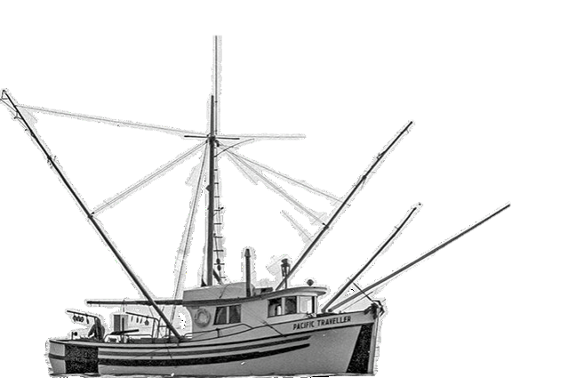
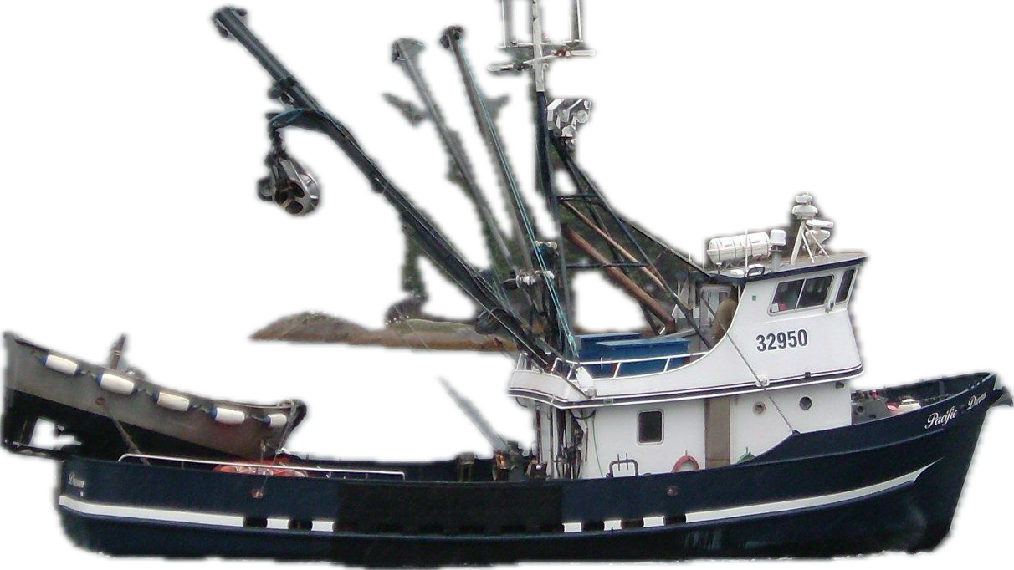
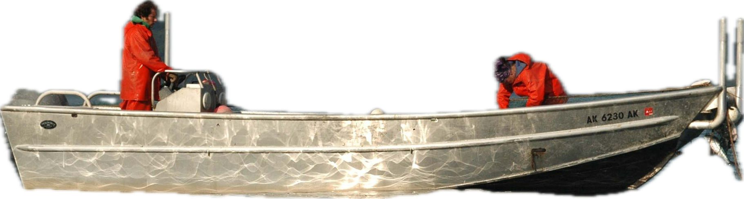
Fishing Vessels
Fishing Vessels range from 130 ft Alaskan King Crabber, to 58 ft limit seiner, to 43 ft salmon troller, to a 24 ft setnet skiff.

Slide 7
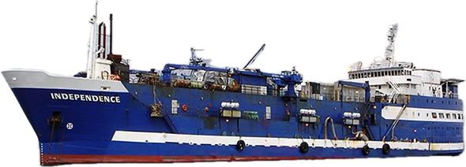
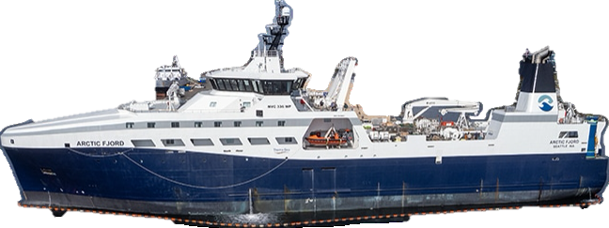
Fish Processor/Factory Vessels
1 Fish Processing Vessel 356 ft, and 4,512 GRT
3 Fish Processing Motherships up to 367 ft and 4,898 GRT
22 Catcher-Processors 210 to 380 ft, up to 4,800 GRT

Slide 8
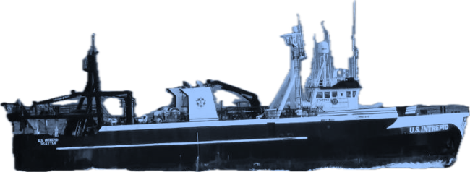
Alternate Compliance
Safety Agreement (ACSA) Fleet
18 enrolled Fishing Vessels that minimally process their catch, but beyond heading, gutting and freezing. Exempted from classification and load line requirements if they maintain satisfactory compliance with ACSA.
8 freezer-trawlers and 10 freezer-longliners ranging from 90 to 250 ft.

Slide 9
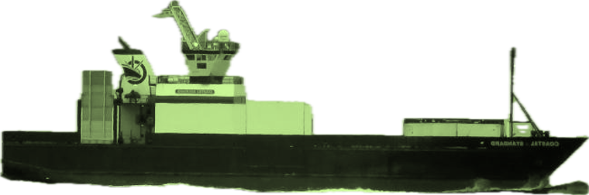
Fish Tender Vessels (ATA)
5 Aleutian Trade Act Fish Tenders
Coastal Freighters delivering west of Kodiak Island, AK
Up to 250 ft and 2500 GT (ITC)

Slide 10
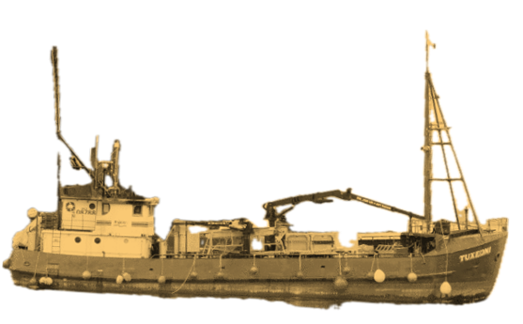
Fish Tender Vessels
Estimate 145 Fish Tender Vessels that transport fish, fishery products or supplies to support the fishing industry.
Almost all Fish Tenders operate in D17.

Slide 11
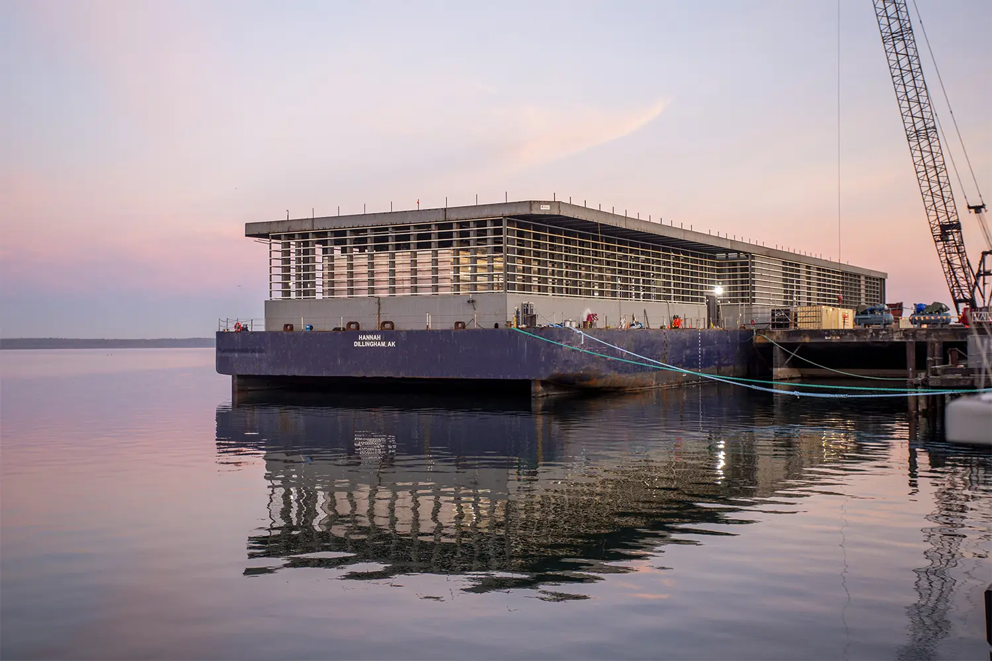
Fish Tender Innovation
2 Major projects underway converting 400 ft deck barges into freezer storage Fish Tenders*. Barges are over 500 GRT and will be Inspected Vessels holding a Certificate of Inspection

Slide 12
Dockside Exam Numbers (2023)
Compared to 2022, number of exams for Sector Puget Sound were down 37% due to staffing shortages; Sector Columbia River's exams were about the same thanks to significant contribution by Auxiliary Examiners.
DOCKSIDE EXAMS
UNIT | EXAMS | DECALS
SEC PUGET SOUND | 247 | 157
SEC COLUMBIA RIV | 361 | 299
DISTRICT TOTAL | 661 | 480

Slide 13
Enforcement Boardings (2023)
Stat: A Fishing Vessel without a current decal is 5 times more likely to have a violation during a boarding.
And, on average, there will be more than 2 violations discovered during the boarding.
DECAL STATUS | # BOARDINGS | NUMBER OF VIOS (TOTAL) | BO W/VIOS | AVG VIOS/BO
CURRENT | 107 | 15 | 9 | 1.7
EXPIRED | 61 | 29 | 14 | 2.1
NO DECAL | 85 | 94 | 37 | 2.5
NEW DECAL* | 13* | 30* | 13* | 2.3
TOTALS | 266 | 168 | 73 | 2.3
*New Decal line-item lists when a vessel obtained a decal AFTER the date of the boarding. So, all violations were corrected and vessel in FULL compliance.

Slide 14
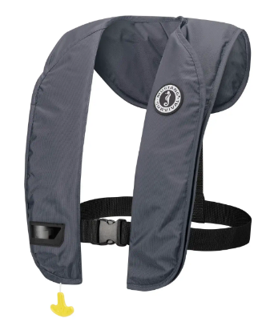
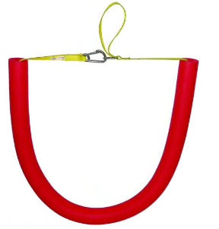
Casualty—Success Story (2023)
A deckhand from a crabber out of Newport, OR, was quickly recovered from the water after falling overboard while retrieving crab pots.
The skipper and other deckhand had attended a drill conductor course and knew the emergency procedure for person overboard. In addition, the vessel was rigged with a recovery device fashioned from a pool-noodle that was used to quickly retrieve the deckhand. The deckhand was wearing an inflatable PFD when he fell overboard.
By WEARING A PFD, having a person overboard RECOVERY DEVICE at-the-ready, and PRACTICING emergency drills, all lead to the deckhand surviving what is too often a fatal event.

Slide 15
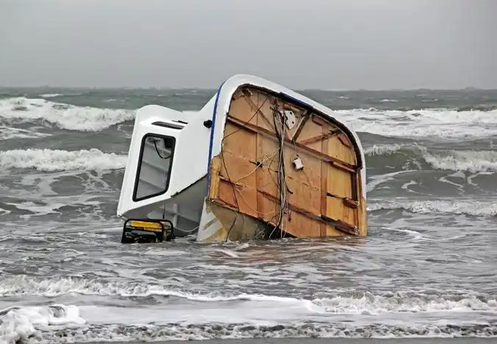
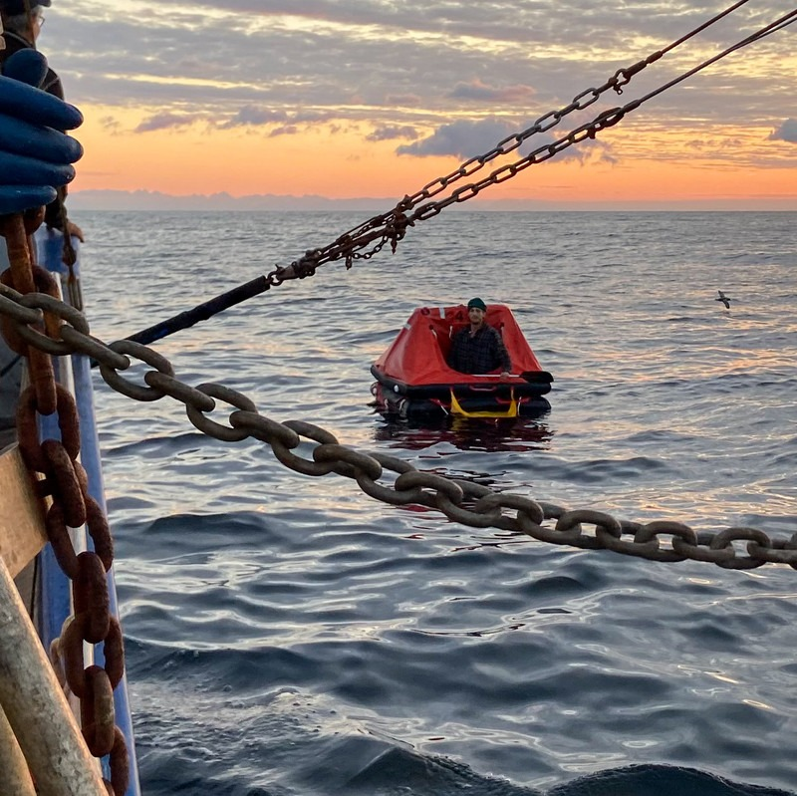
Casualties (2023)
VESSELS LOST: 6
FATALITIES: 2
LIVES SAVED: 5
F/V ETHEL MAY: Feb 5, 2023--Willapa Bay, WA: 46.6 ft, wood hull, built in 1948, Dungeness crabber with 3 POB, was inbound across the Willapa Bay Bar when two breaking waves came over the stern. Vessel became awash and capsized. All persons abandoned the vessel but only 2 made it into the life raft. One person was never seen again.
F/V EVENING: Oct 12, 2023--Off coast of Grays Harbor, WA: 43.4 ft, wood hull, built in 1941, tuna troller with 2 POB and a dog, was returning to port after 2 days of tuna fishing. The weather was very rough with a quartering sea. Vessel listed sharply and capsized. Deckhand made it to the liferaft but skipper and the dog were never seen again. Deckhand survived 13 days in the liferaft until being picked up by a Canadian Fishing Vessel 70 nm NW of Cape Flattery, WA.

Slide 16
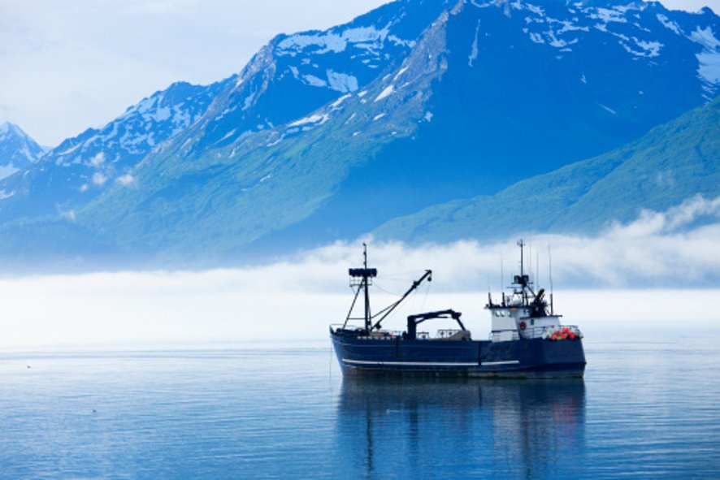
Mike Rudolph
USCG Thirteenth District (dpi)
Seattle, WA
Michael.G.Rudolph@uscg.mil
Office: 571-607-1761
Cell: 206-259-0087

